Slide 1
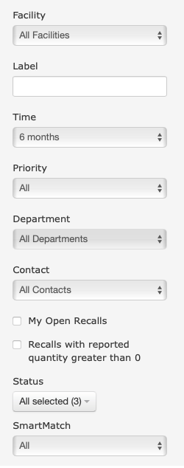
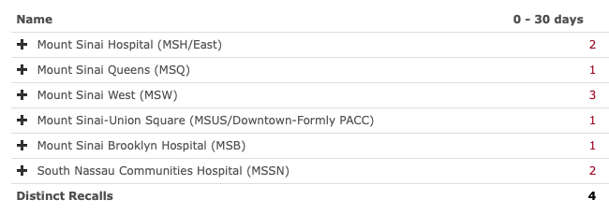
Inventory Action
1
1 N/A
1
N/A
N/A
2 N/A

